Slide 1
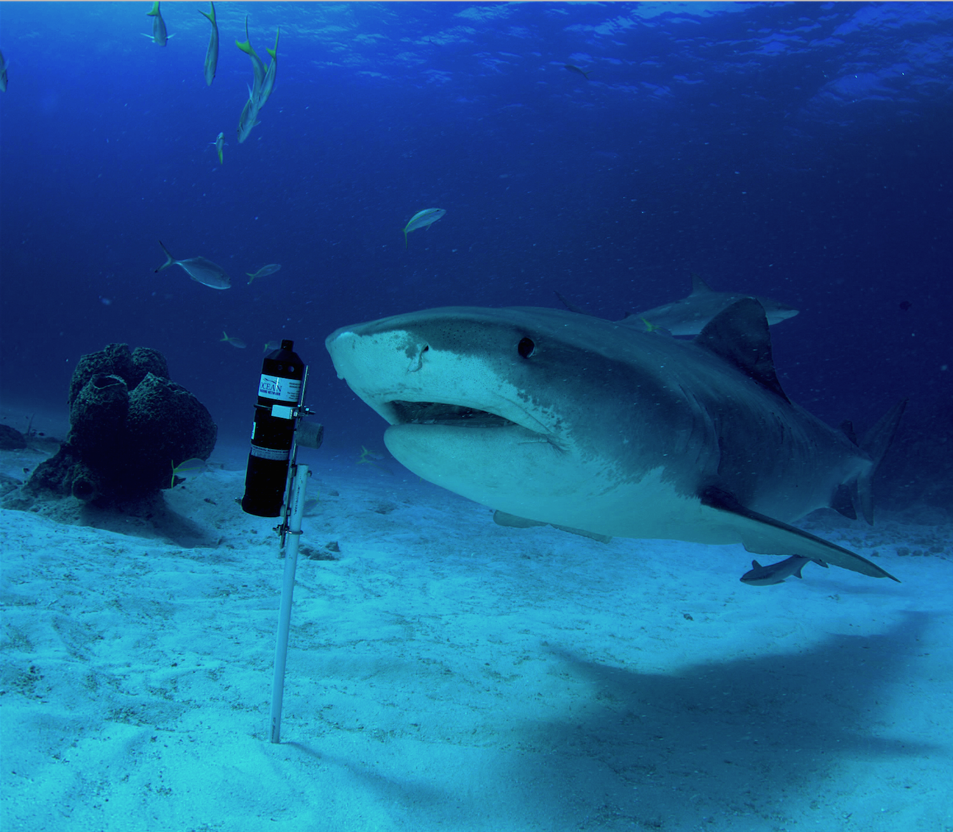
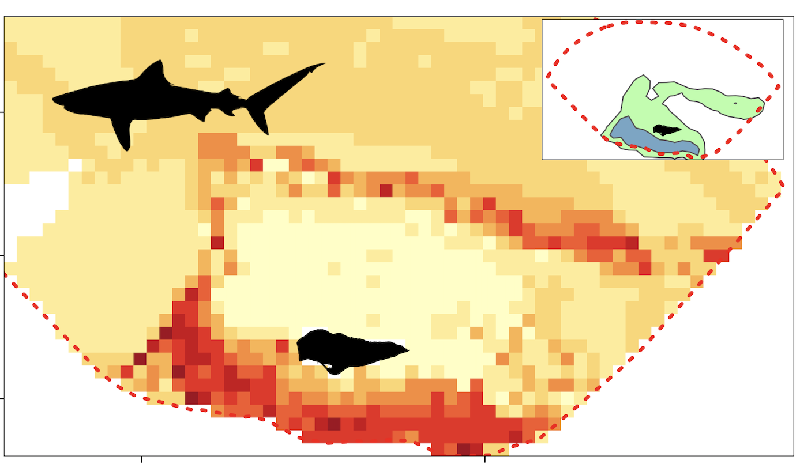
Relative Habitat Selection and Resource Selection Functions in Aquatic Acoustic Telemetry: Theory, Application, and Process
photo: Jim Abernethy, https://oceantrackingnetwork.org
Lucas Griffin
Assistant Professor
University of South Florida
Jonathan Rodemann
Postdoctoral Associate
Florida International University

Slide 2
Roadmap for today
Modeling Habitat Selection
Terrestrial vs. Aquatic
Approach with Acoustic Telemetry
Considerations and Next Steps
Hands-on Code with Seatrout Example

Slide 3
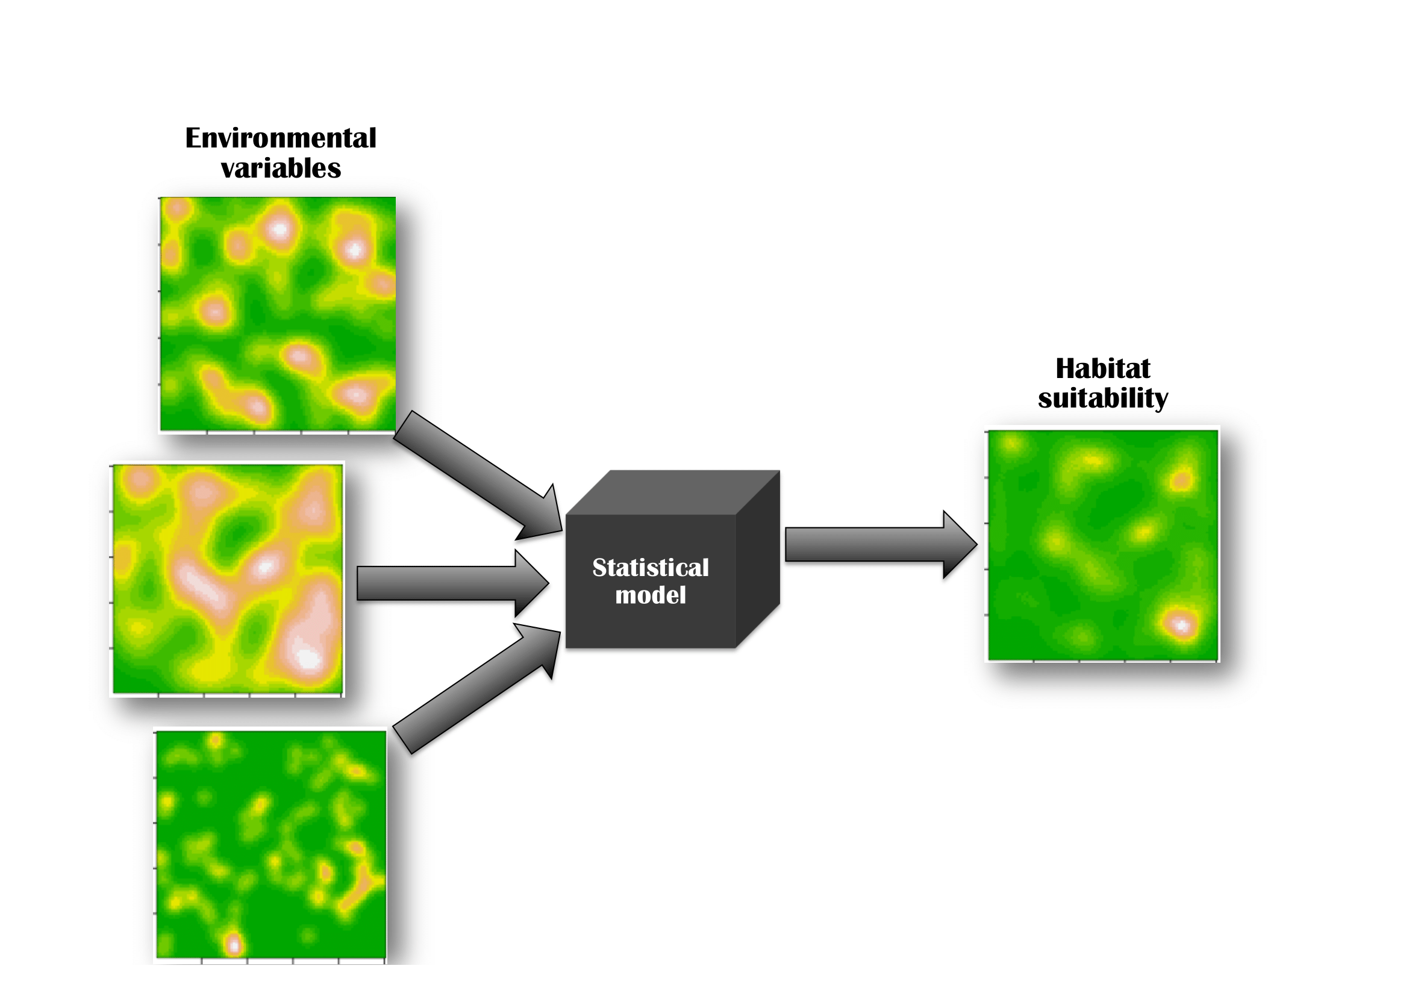
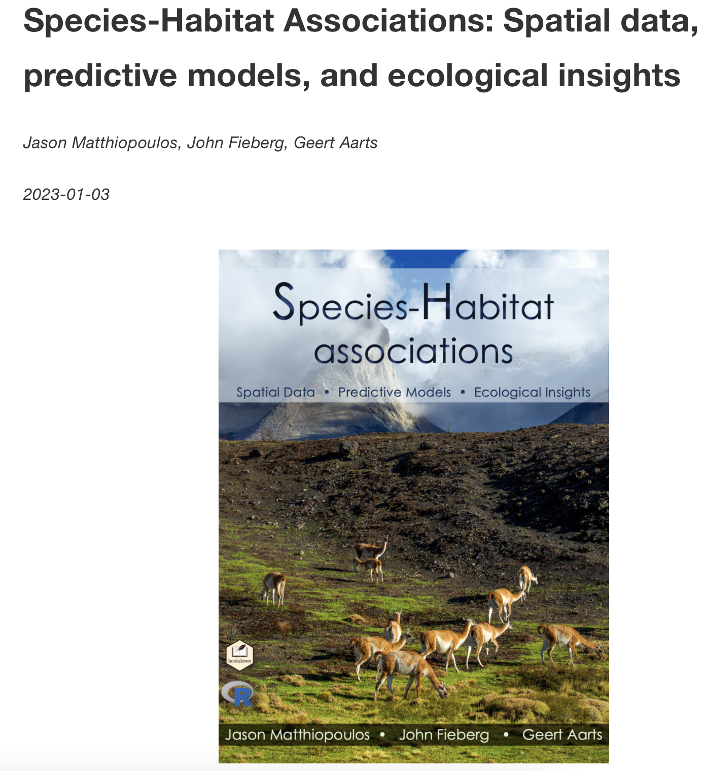
What habitats do animals like or avoid?
Matthiopoulos et al. 2023

Slide 4
What habitats do animals like or avoid?
Species Distribution Models & Resource Selection Functions
Input
Locations of individuals
Random assignment of locations, also known as pseudo-absences
Output
Distribution as a function of resources, risks, conditions

Slide 5
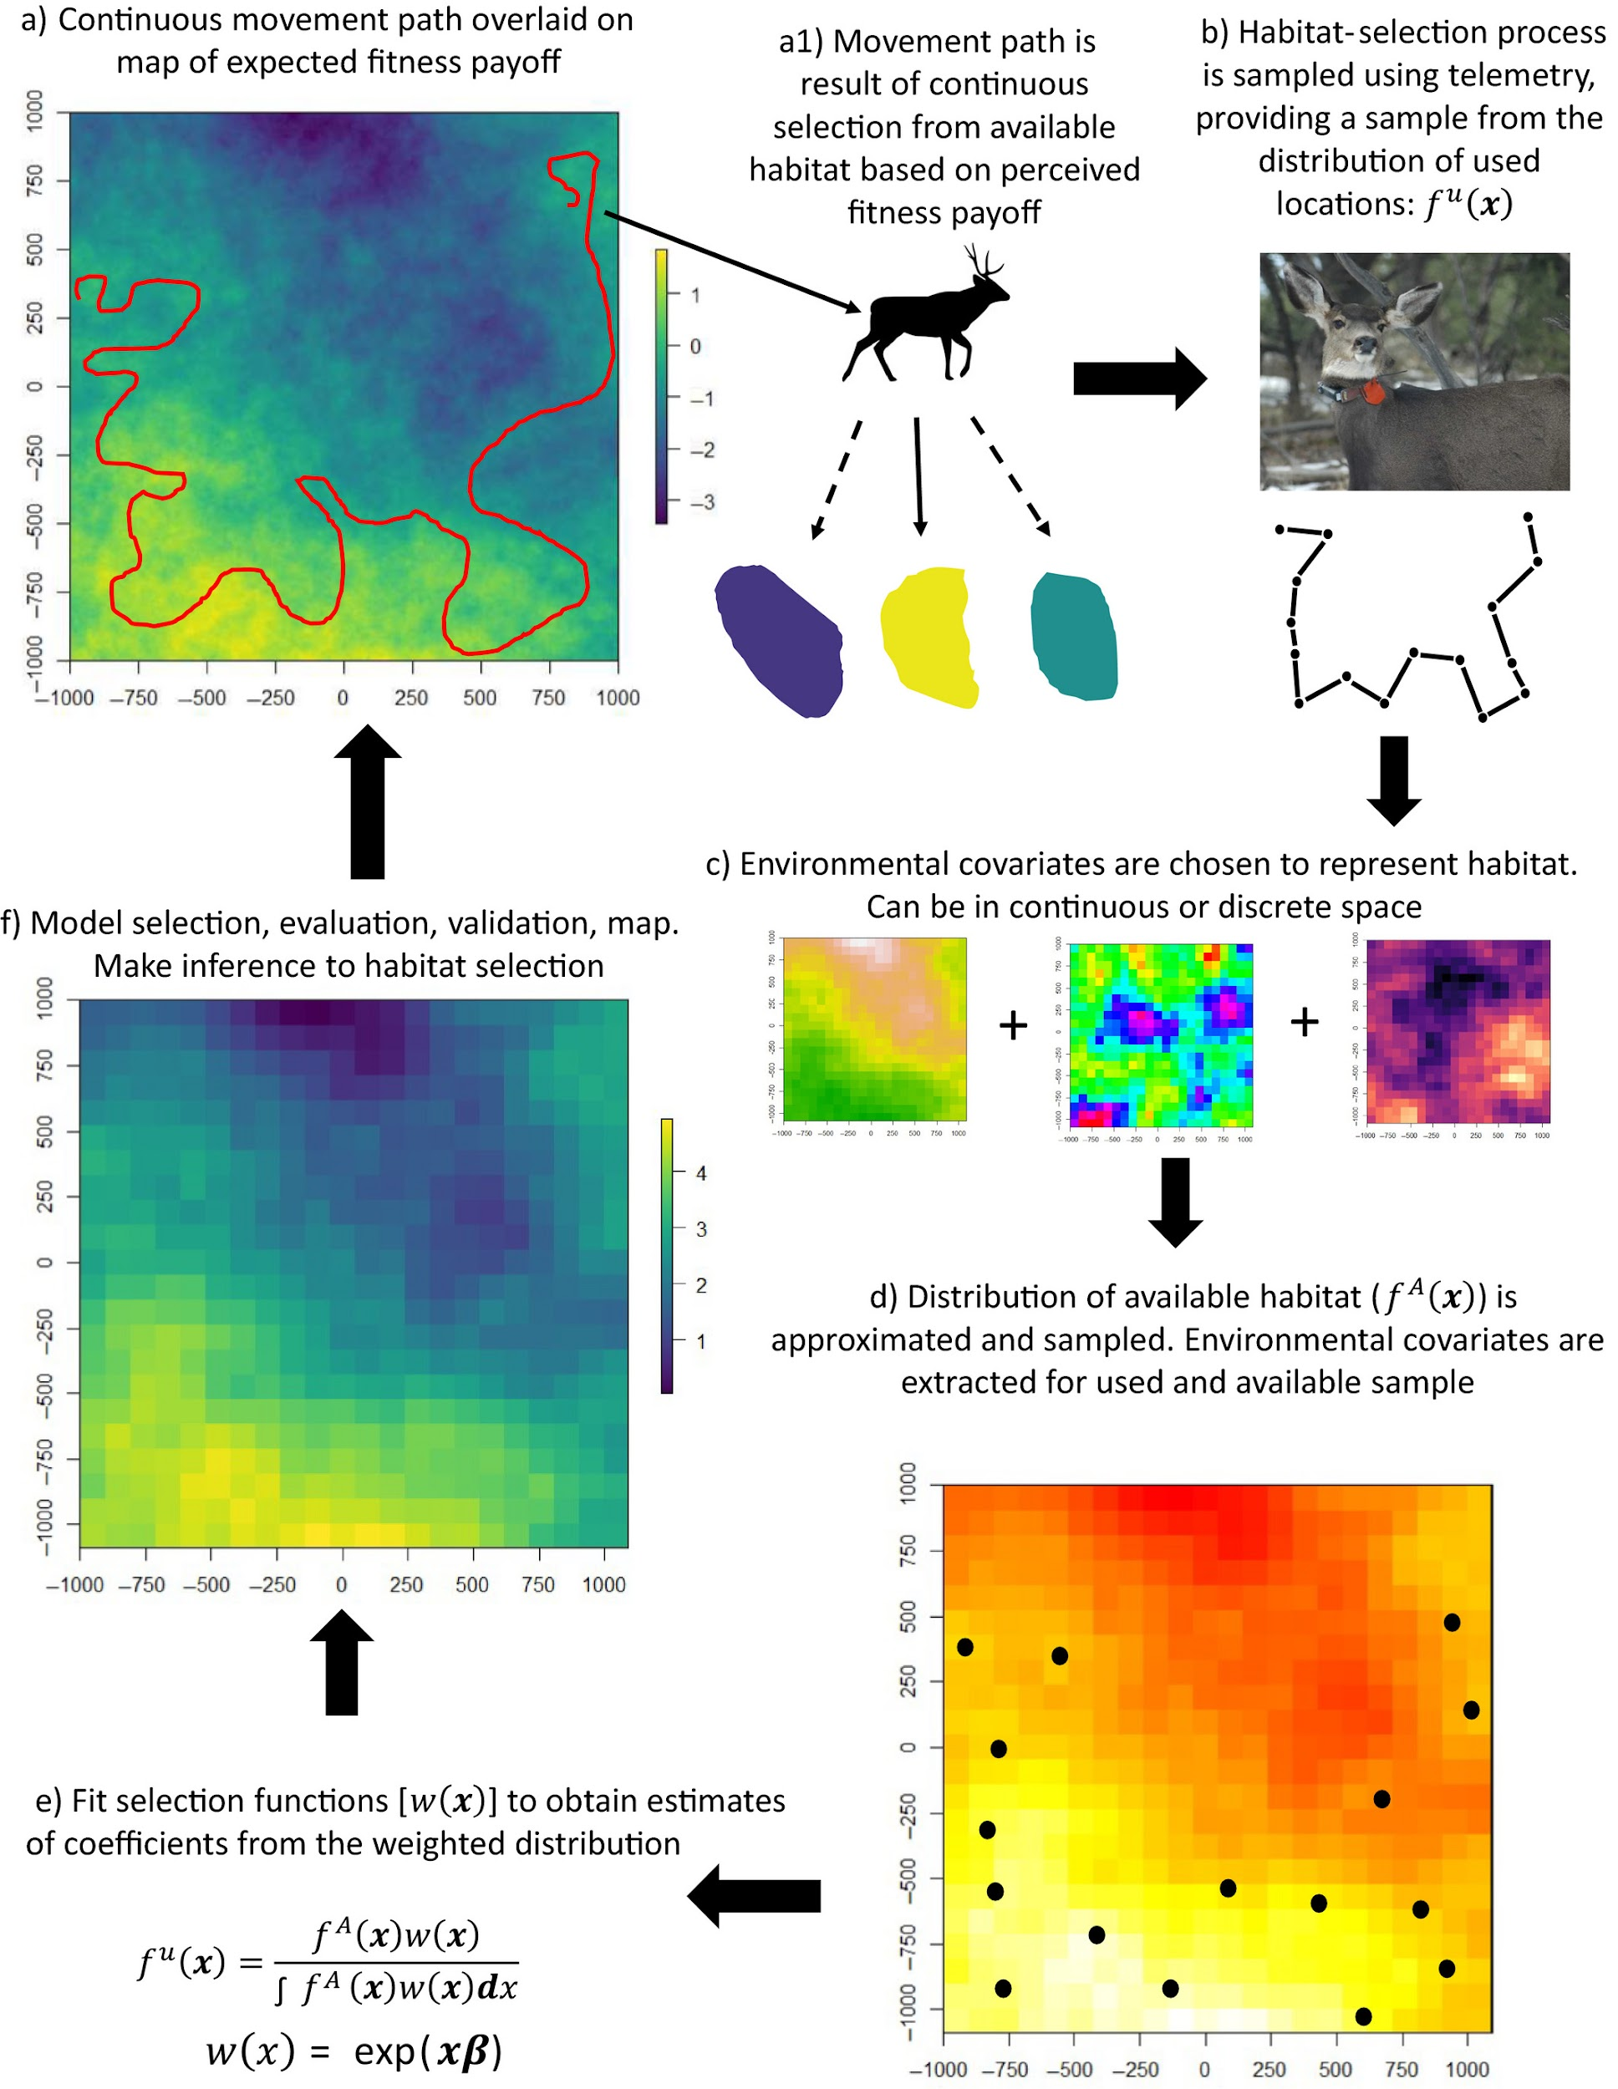
Northrup, J.N., et al. (2012). Ecological Applications.

Slide 6
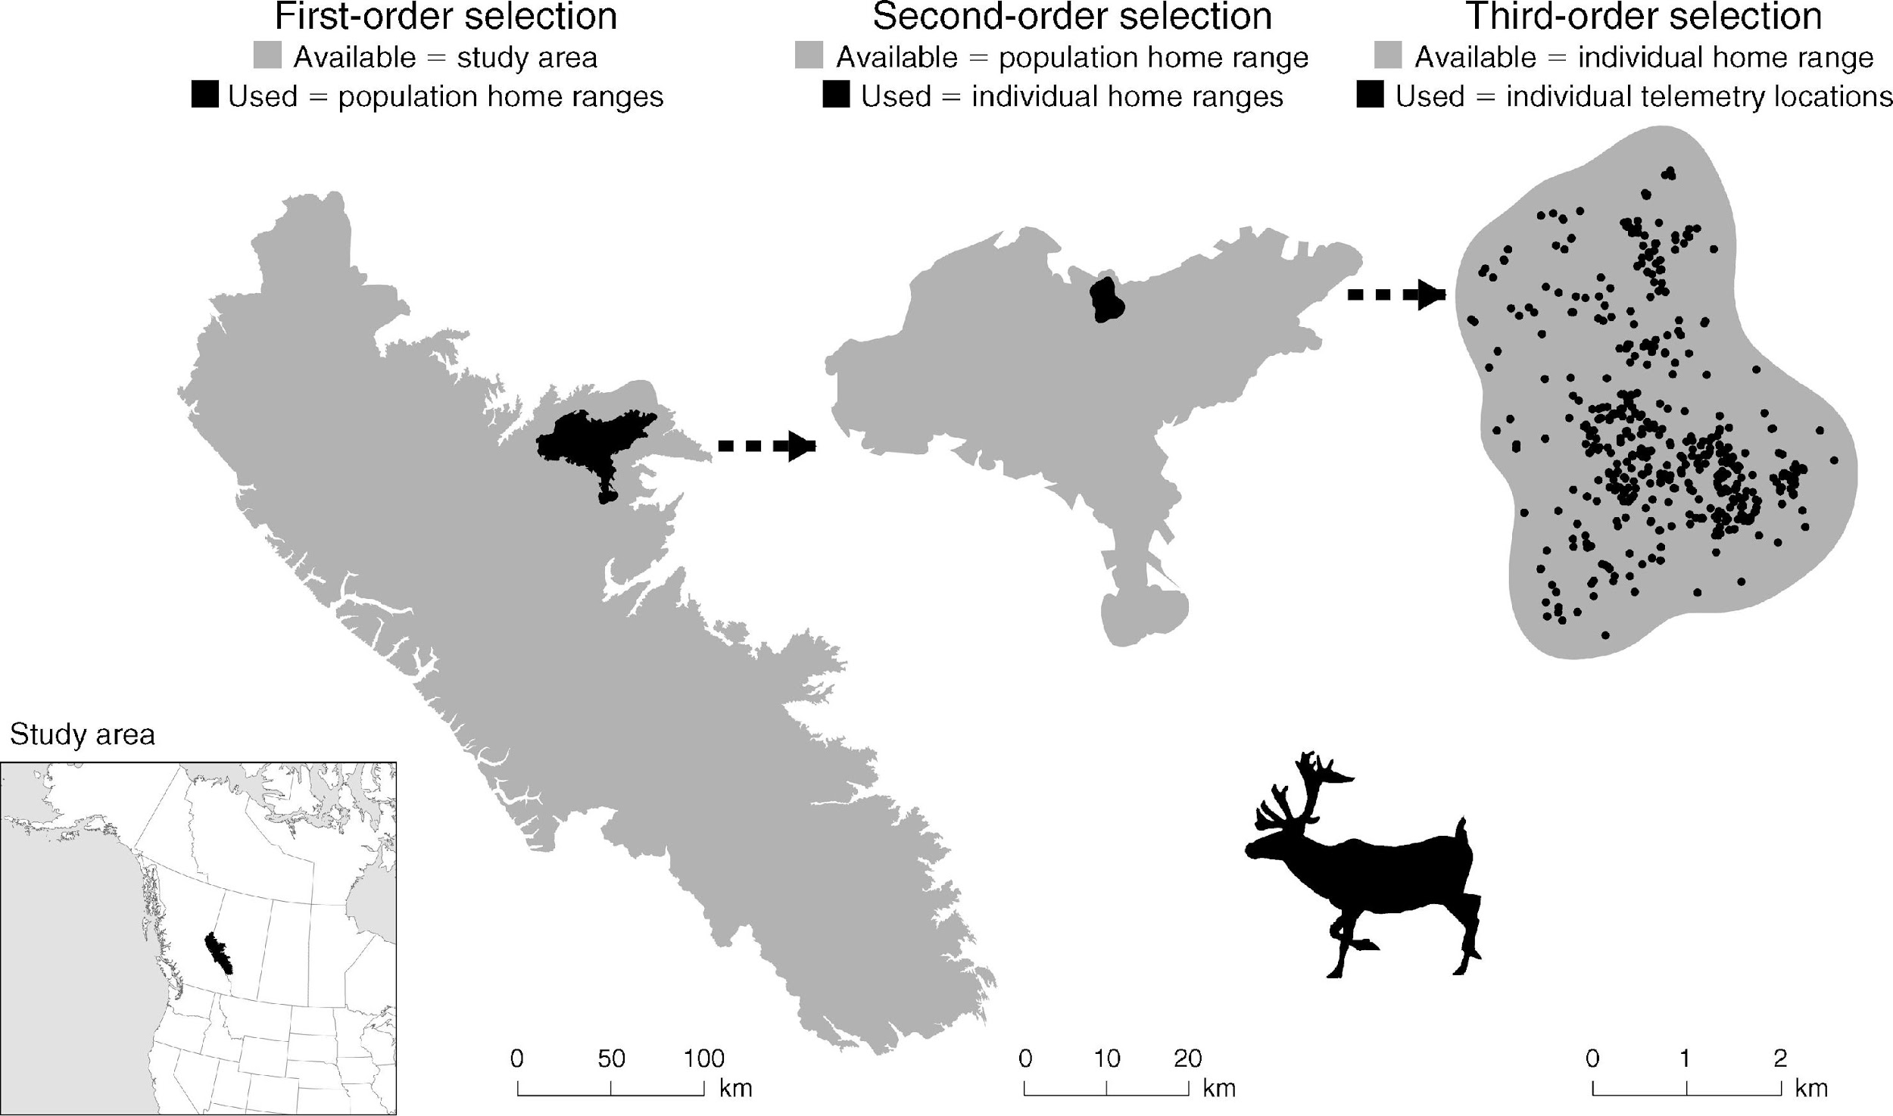
What habitats do animals like or avoid?
DeCesare, N. J., Hebblewhite, M., Schmiegelow, F., Hervieux, D., McDermid, G. J., Neufeld, L., ... & Musiani, M. (2012). Transcending scale dependence in identifying habitat with resource selection functions. Ecological Applications, 22(4), 1068-1083.
Notes:
Just briefly, when we think about habitat selection, we can think about habitat use vs available habitat at several scales.
- Using caribou as an example, here on the left, we examine population home ranges use across a region,
or in the middle, individual home range use within a population home range, and then finally,
on the right, which applies to most of us, we have individual telemetry locations relative to an individual’s home range.
So within each scale, we are comparing the area of use, as colored in black, to the areas that are available to an individual or population, which is colored in grey.
In the telemetry world, we typically have what we call presence only data, meaning we know where the animal was but we don’t know necessarily know where the animal was not.
So in these situations, we can statistically, using what's called a resource selection function, compare our known presences with a randomly generated sample of pseudo-absences across our ‘available’ resource units.
So here, we would compare our black points, known locations, with pseudo-absences across the available habitat (the grey).
#########
Animal spatial data, from sources such as telemetry, can be incorporated into RSFs to define the relative habitat selection strengths among animal space use and a given set of environmental covariates, such as habitat type, substrate, elevation, or water depth (Boyce and McDonald, 1999). When the true absences are unknown, as generated by presence only data derived from sources such as telemetry approaches, RSFs are implemented within a use/availability framework where known presences (1) are compared with a random sample across ‘available’ resource units, also known as pseudo-absences or background points (0)
1834 AT studies published between 1969 and 2019 primarily focused on describing or quantifying spatial patterns of animals, termed 'ecology' here (n = 1442
Matley, J. K., Klinard, N. V., Martins, A. P. B., Aarestrup, K., Aspillaga, E., Cooke, S. J., ... & Fisk, A. T. (2021). Global trends in aquatic animal tracking with acoustic telemetry. Trends in Ecology & Evolution.
DeCesare, N. J., Hebblewhite, M., Schmiegelow, F., Hervieux, D., McDermid, G. J., Neufeld, L., ... & Musiani, M. (2012). Transcending scale dependence in identifying habitat with resource selection functions. Ecological Applications, 22(4), 1068-1083.

Slide 7

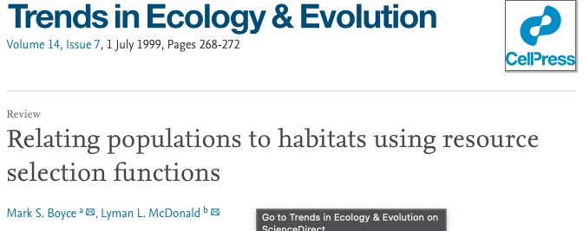
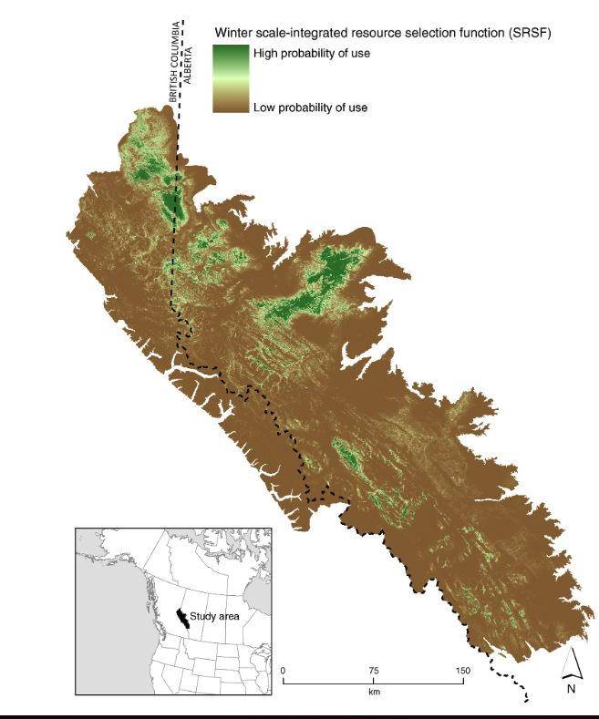



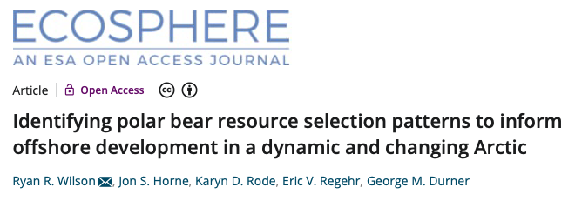

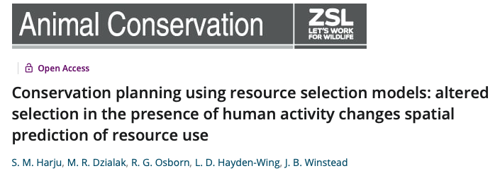
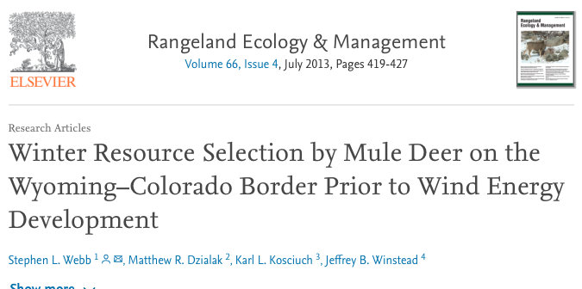
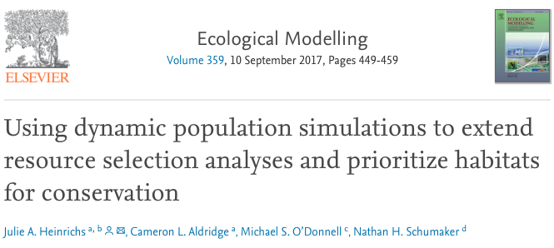
DeCesare, N. J et al. (2012). Ecological Applications.
Notes:
When done across scales, we can spatially predict the probability of use or selection of an animal and its population. So here, green are areas of high selection, vs brown, where we expect the lower selection values for caribou.
Now, this application of resource selection functions has been used extensively within the terrestrial world since the 1980s, and also has been commonly used with satellite data. Specifically, you may have seen this with whales.
###########
1834 AT studies published between 1969 and 2019 primarily focused on describing or quantifying spatial patterns of animals, termed 'ecology' here (n = 1442
Matley, J. K., Klinard, N. V., Martins, A. P. B., Aarestrup, K., Aspillaga, E., Cooke, S. J., ... & Fisk, A. T. (2021). Global trends in aquatic animal tracking with acoustic telemetry. Trends in Ecology & Evolution.
DeCesare, N. J., Hebblewhite, M., Schmiegelow, F., Hervieux, D., McDermid, G. J., Neufeld, L., ... & Musiani, M. (2012). Transcending scale dependence in identifying habitat with resource selection functions. Ecological Applications, 22(4), 1068-1083.

Slide 8
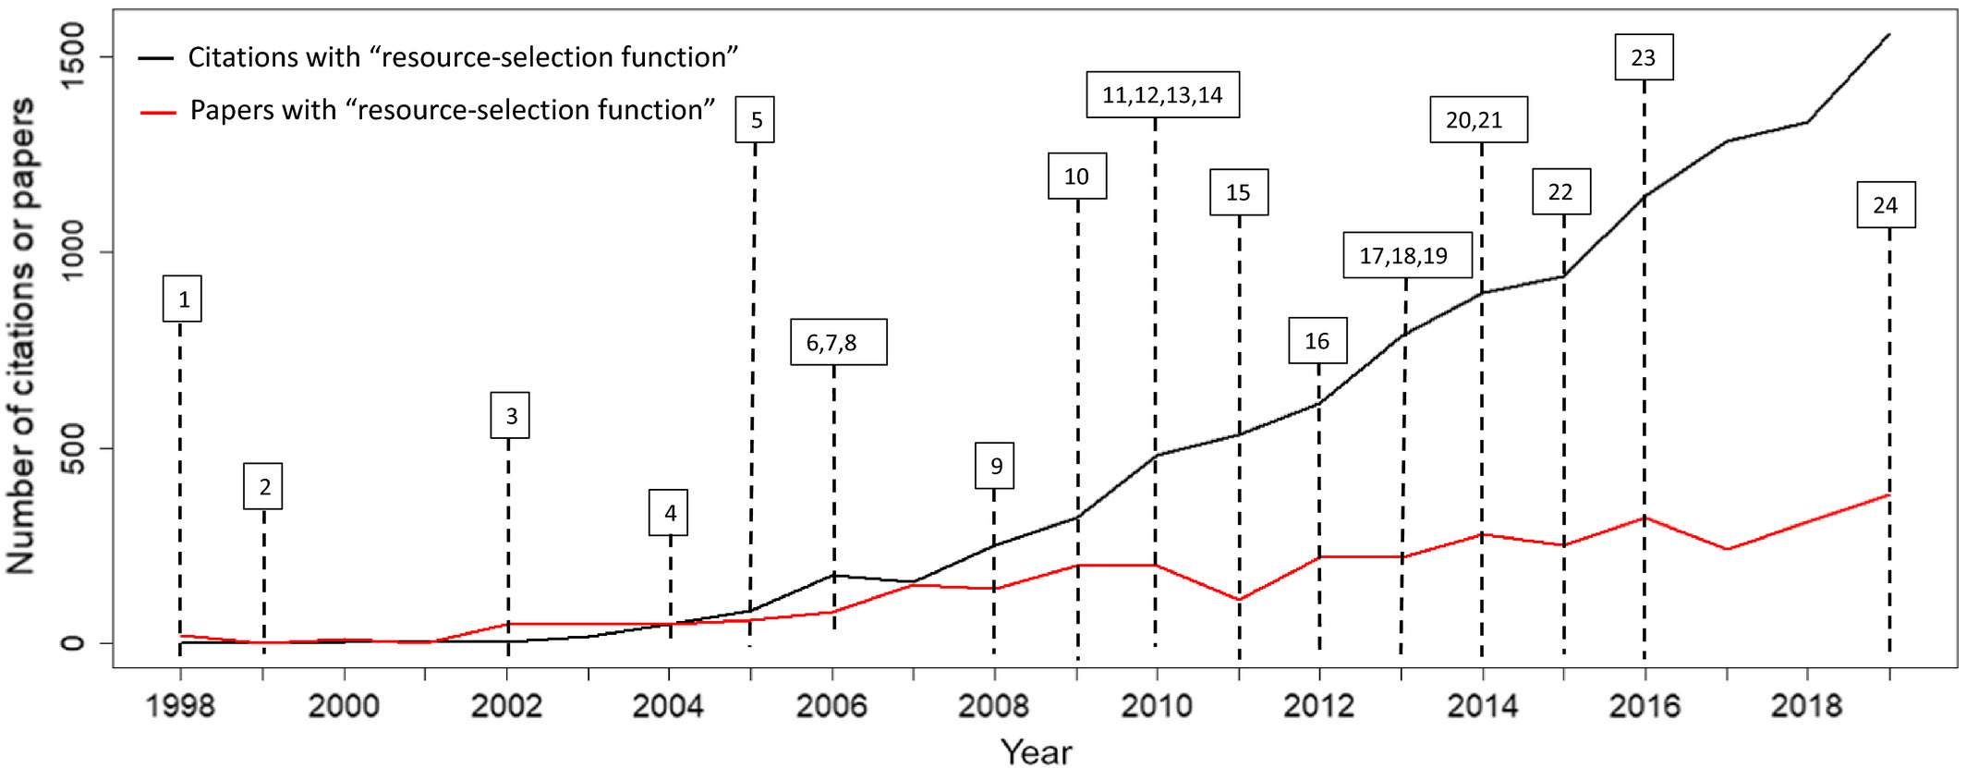
Northrup, J.N., et al. (2012). Ecological Applications.
Notes:
Number of citations and publications annually for papers with keywords “resource‐selection function,” the type of selection function most commonly applied in the literature, over time based on a Web of Science search. Numbers reference citations below, which comprise some of the key advancements made in modeling resource selection, helpful reviews, or highly cited papers. 1Mysterud and Ims (1998a), 2Boyce and McDonald (1999), 3Boyce et al. (2002), 4Keating and Cherry (2004), 5Fortin et al. (2005), 6Gillies et al. (2006), 7Johnson et al. (2006), 8Lele and Keim (2006), 9Johnson et al. (2008), 10Forester et al. (2009), 11Fieberg et al. (2010), 12McLoughlin et al. (2010), 13Warton and Shepherd (2010), 14Beyer et al. (2010), 15Matthiopoulos et al. (2011), 16Aarts et al. (2012), 17Northrup et al. (2013), 18Johnson et al. (2013), 19Lele et al. (2013), 20Hooten et al. (2014), 21van Beest et al. (2014b), 22Matthiopoulos et al. (2015), 23Avgar et al. (2016), 24Muff aet al. (2020).

Slide 9
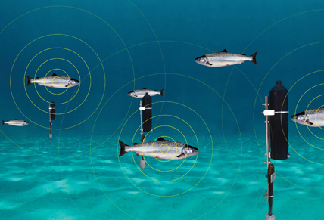
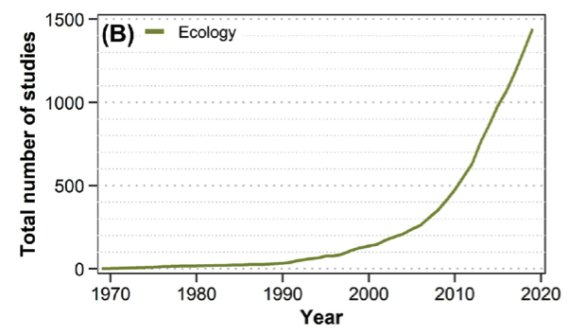
https://oceantrackingnetwork.org
Matley, J. K., et al. (2021). Global trends in aquatic animal tracking with acoustic telemetry. Trends in Ecology & Evolution.
Notes:
Now in our world, that uses acoustic telemetry, of the nearly 1,500 published acoustic telemetry articles focused on ecology since 1969, there has been only 7studies that have used this framework.

Slide 10
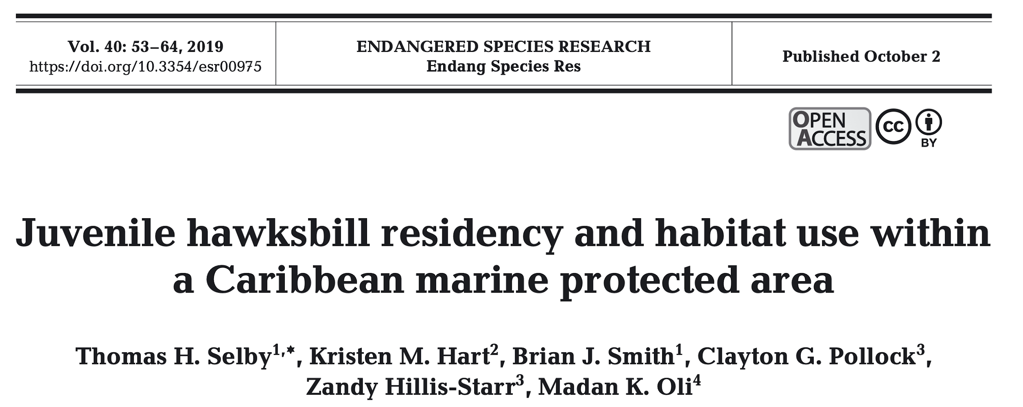

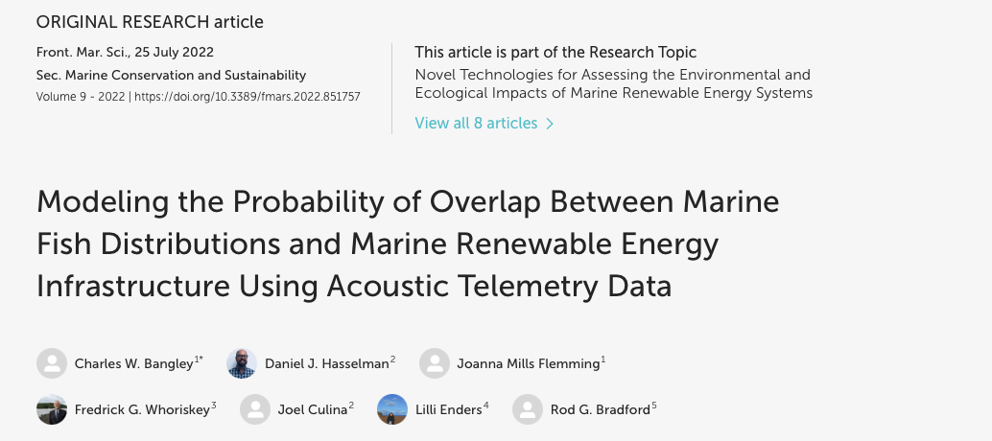
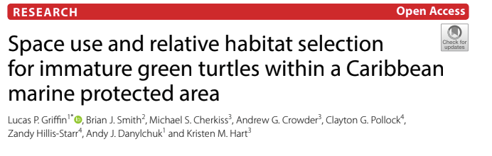
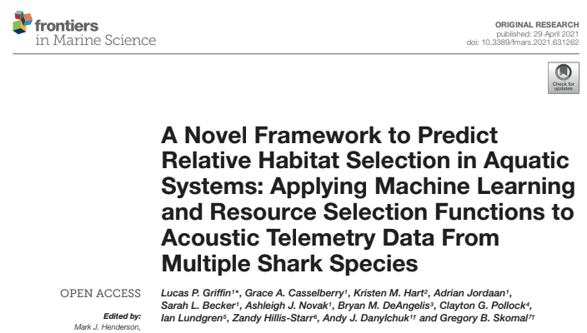
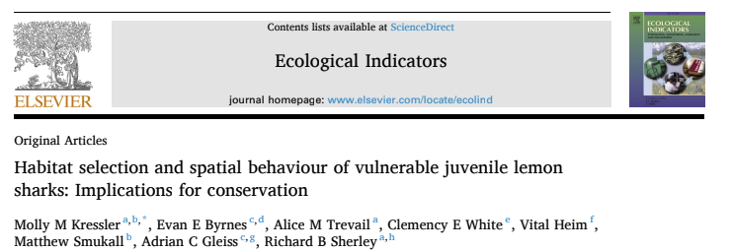
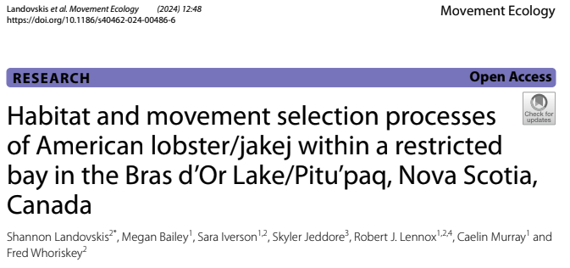
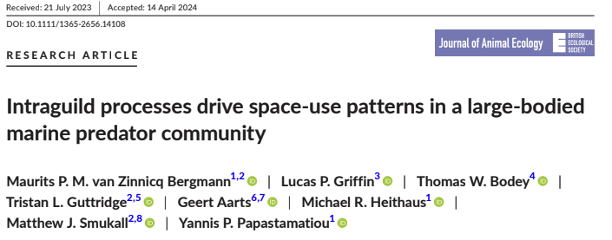
Notes:
Now in our world, that uses acoustic telemetry, of the nearly 1,500 published acoustic telemetry articles focused on ecology since 1969, there has been only 7studies that have used this framework.

Slide 11
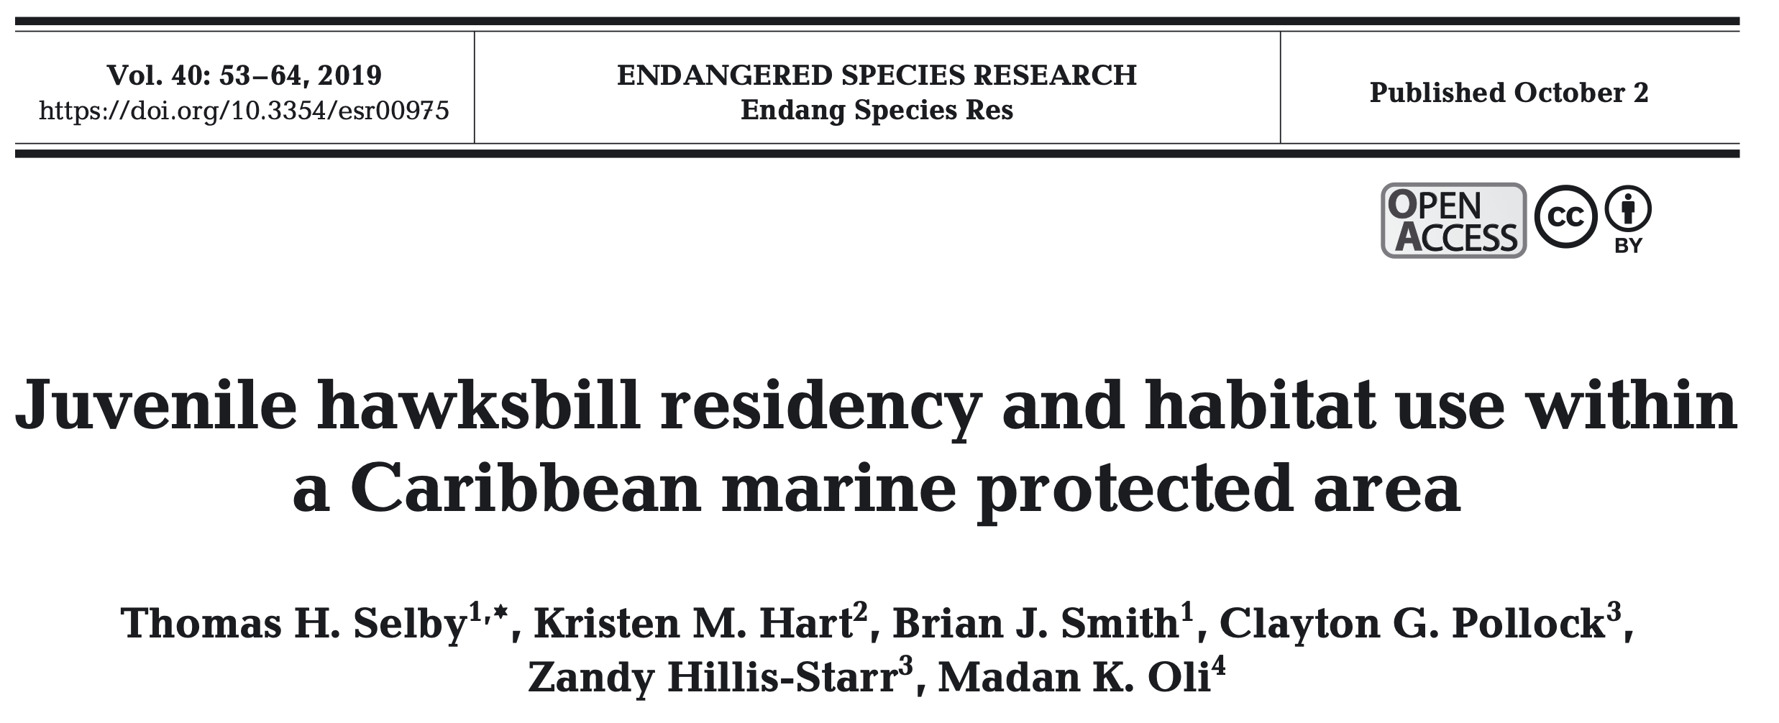
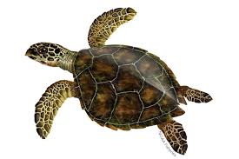
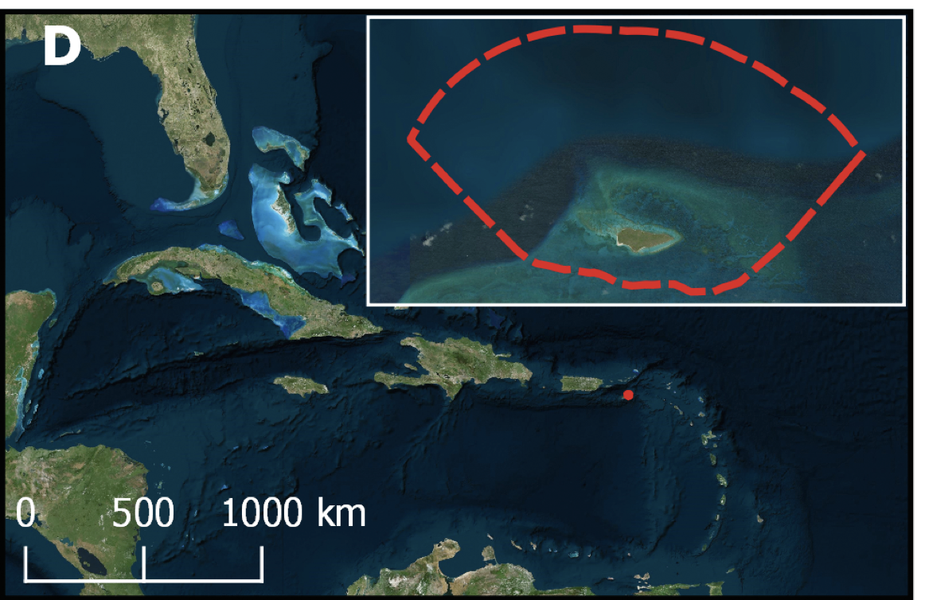

Slide 12
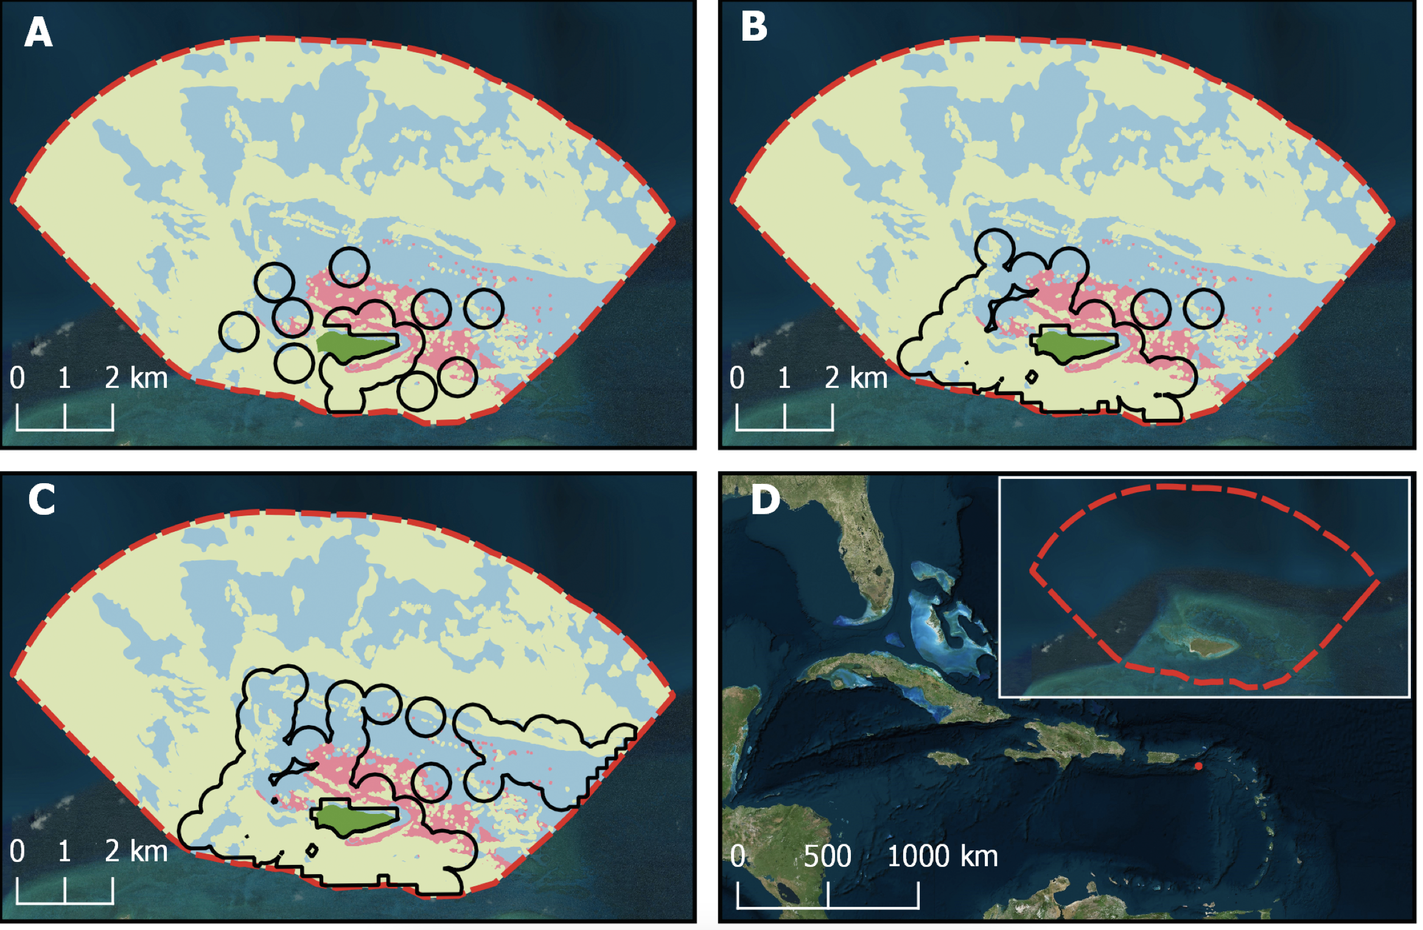
Selby et al. (2019). End. Spec. Res.

Slide 13
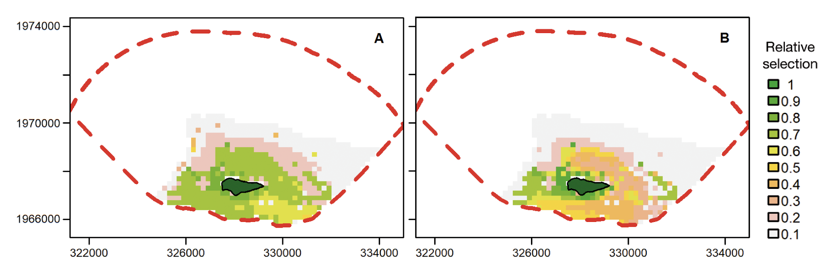

Slide 14
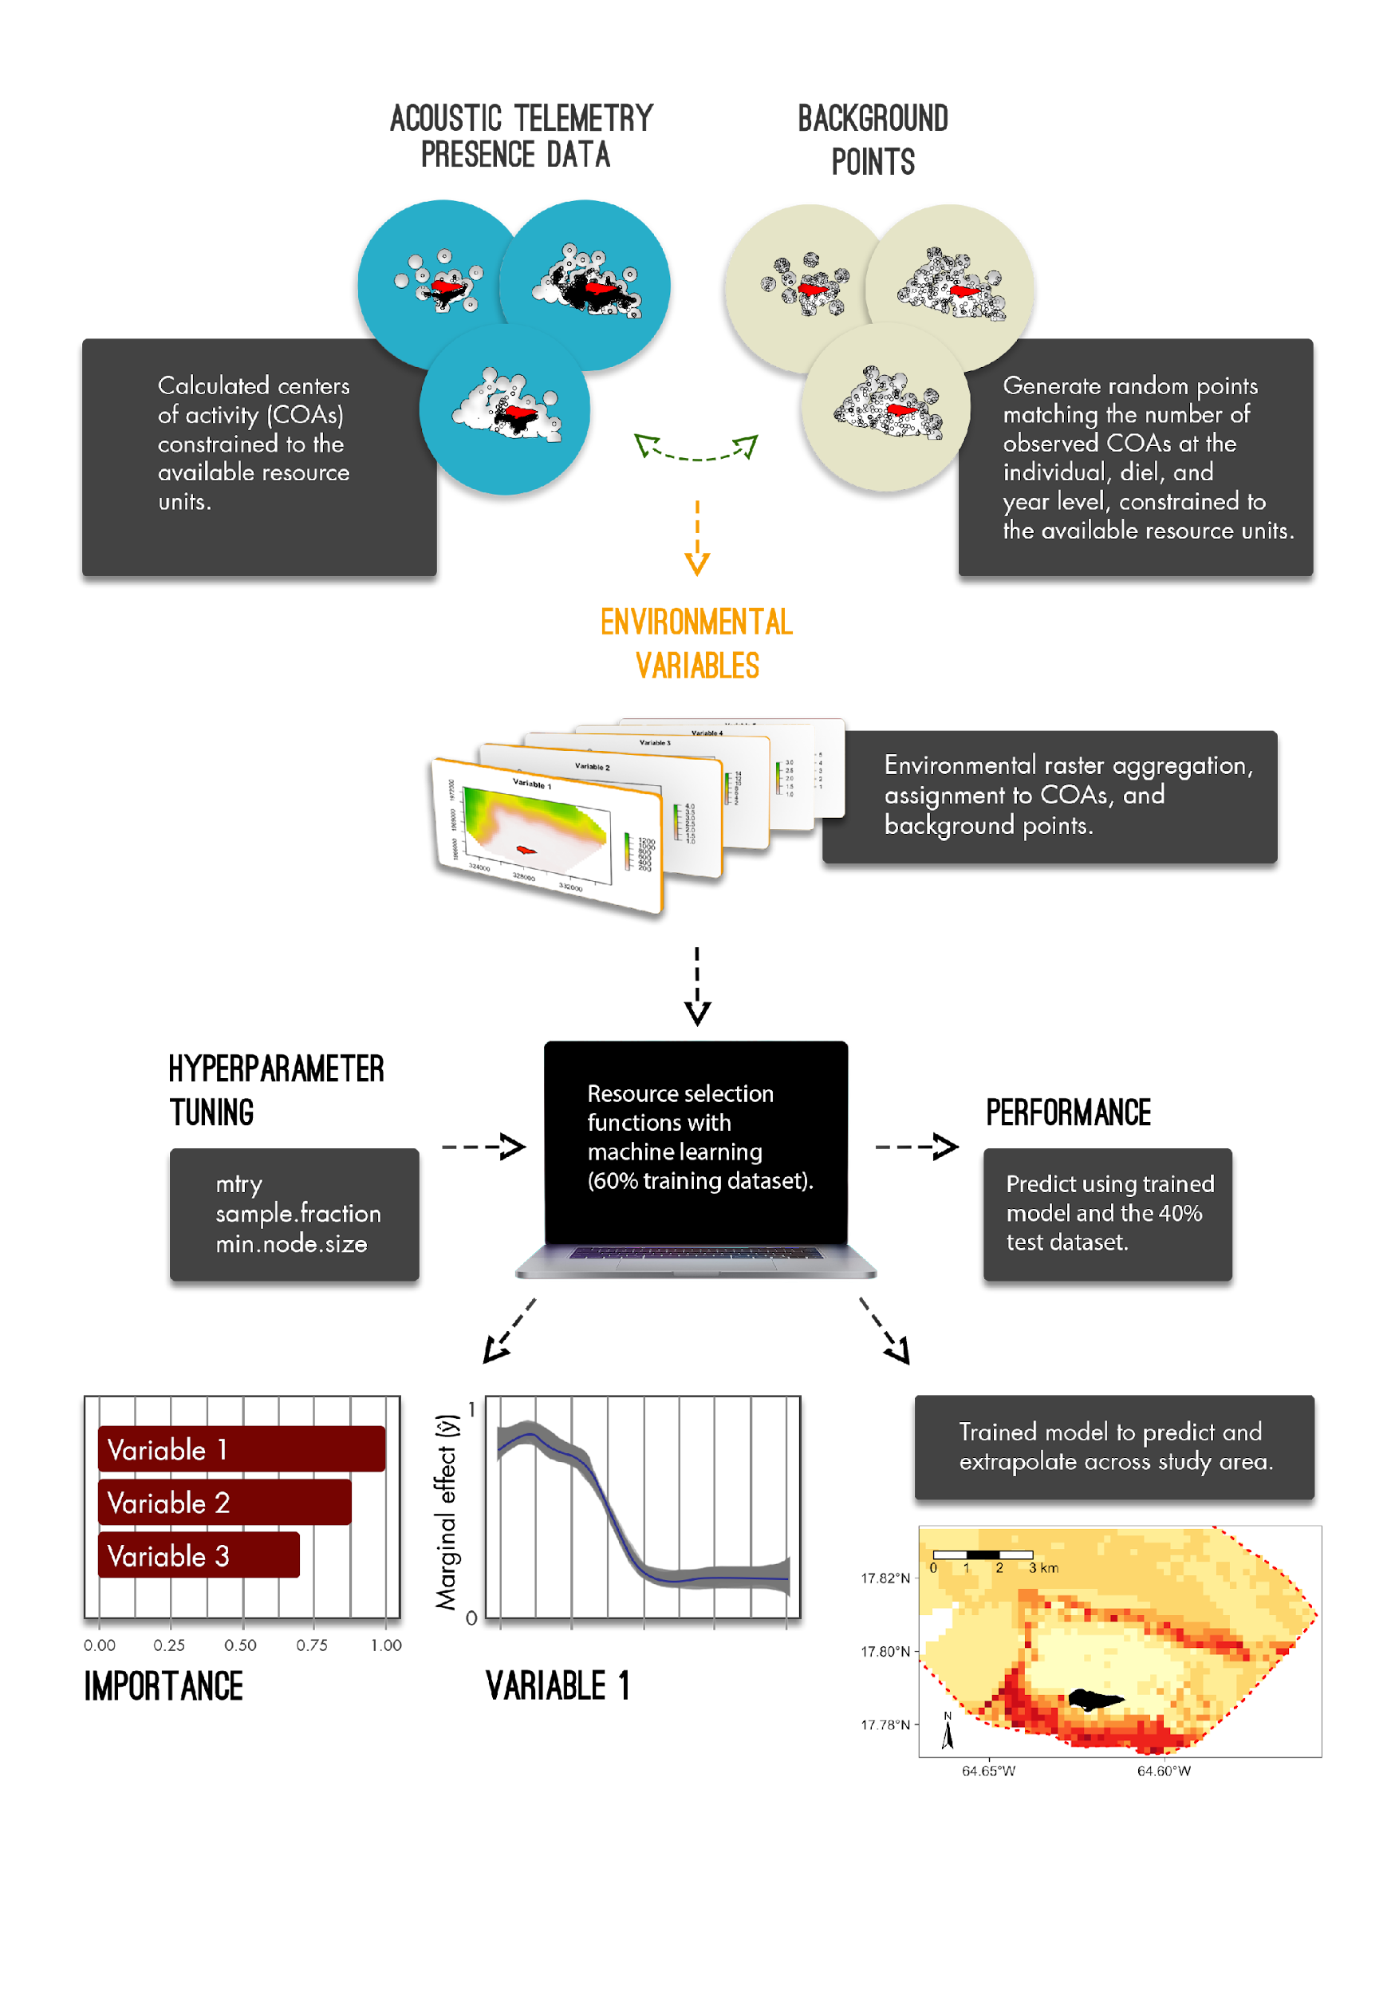
Griffin et al. (2022) Front. Mar. Sci.
Notes:
And this is a huge untapped field for us that use broad scale acoustic telemetry arrays. We all know our acoustic telemetry data, that is presence only, is tricky to work with but it's actually well catered for resource selection functions.
So on the left we have our island in red, detections in black, and our acoustic array and its detection coverage in white. Note that the array changes in size across three separate years which is common in most of our projects which is okay with this approach. Using our detection areas as the available habitat, we can just as easy randomly generate pseudoabsences, also known as background points, that will be compared against our known presences.
We then overlay this data with our environmental variables, submerged vegetation, coral reef structure, depth, etc.

Slide 15
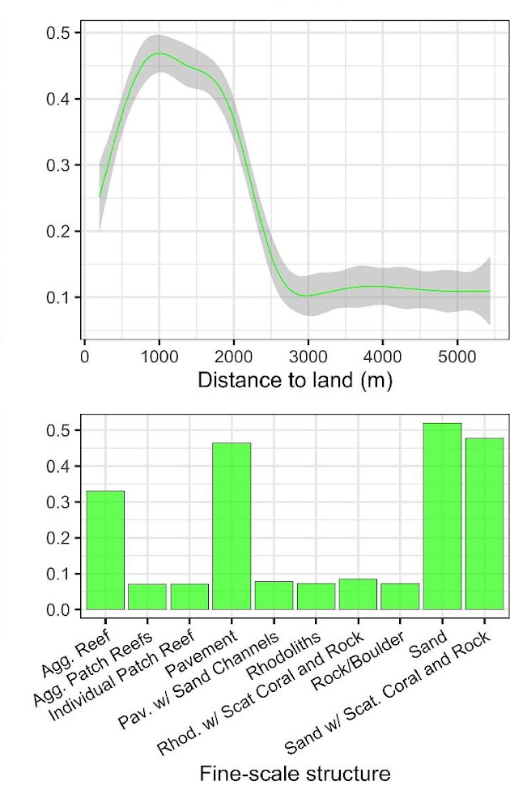
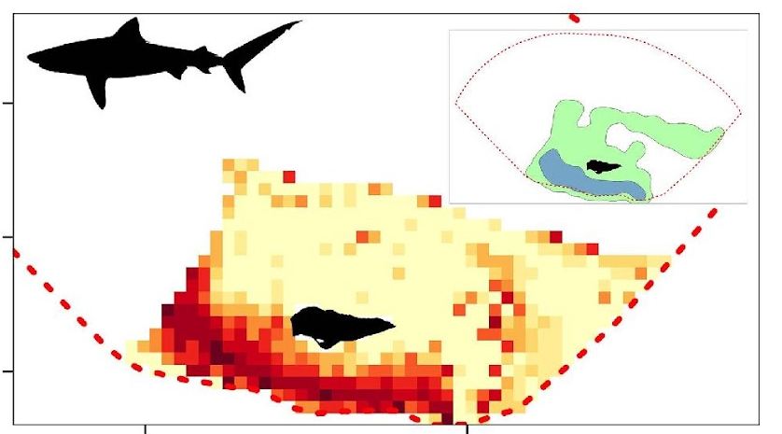
Notes:
- And then we either use logistic regression or machine learning algorithms to compare our known presences (our 1s) against our pseudo-absences (our zeros) relative to the available habitats of our study area,
- this can both provide a better understanding of the underlying ecological phenomenon as well as be used to predict relative habitat selection across the study area, in areas where no detection coverage existed.

Slide 16
Considerations with RSFs and Acoustic Telemetry
Array Design
Does it cover all representative habitats? Home range of animal?
How does detection efficiency get incorporated?
What’s your available habitat delineation?
Deriving location data
Centers of activity, correlated random walks, etc. (see patter package)
Location to pseudo-absence points ratio
Spatial and temporal autocorrelation
Modeling approach
Thinning the data
Habitat variables
Static vs dynamic
Scales
Extrapolations:
How robust are predictions into new systems (see dsmextra package)

Slide 17
Seatrout Example

Slide 18
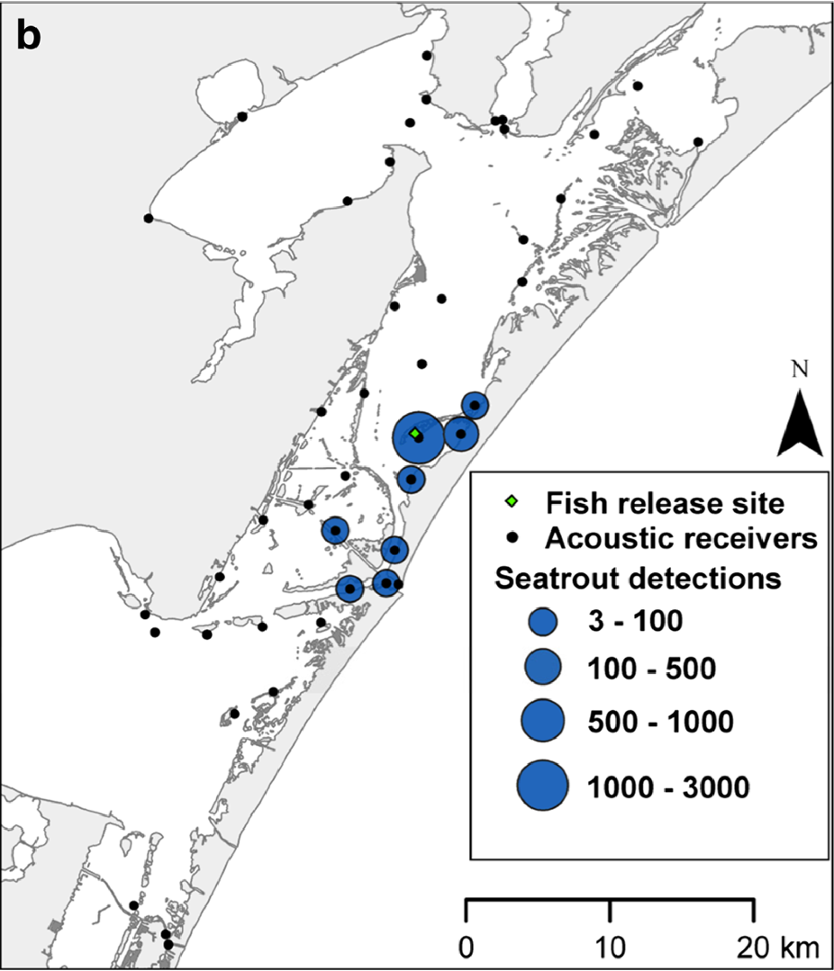
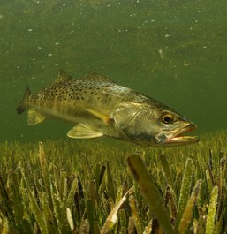

Spotted Seatrout (Cynoscion nebulosus)
Moulton et al., 2017 Estuar Coasts
Notes:
So now I get to introduce you to one of the best fish species in the world (no citations for that, its just a fact), the Spotted Seatrout! This beautiful species has a geographic range from Cape Cod, Massachusetts down around Florida all the way to Mexico. It is the most caught marine recreational species in the United States, with 60 million caught each year!
In Florida, an estimated 13.8 million Seatrout are caught recreationally each year, with catches highest along the Gulf of Mexico coast.
Spotted Seatrout are estuary-dependent species and exhibit high residency within their home estuary. Acoustic tagging studies found that for the most part they do not move further than 10 km away from where they were tagged. An example of this is Moulton et al 2017. You can see by the map that they are relatively residential. Furthermore, genetics studies have shown that each estuary in Florida harbors its own sub-population of Seatrout! They also have a wide range of physical tolerances due to being an estuarine species.
Furthermore, Seatrout have been shown to be associated with seagrass throughout their life cycle! Larvae settle into seagrass beds and juveniles have also been caught more over seagrass. Adult seatrout forage in seagrass seascapes, feeding on seagrass-associated fish and crustaceans.

Slide 19
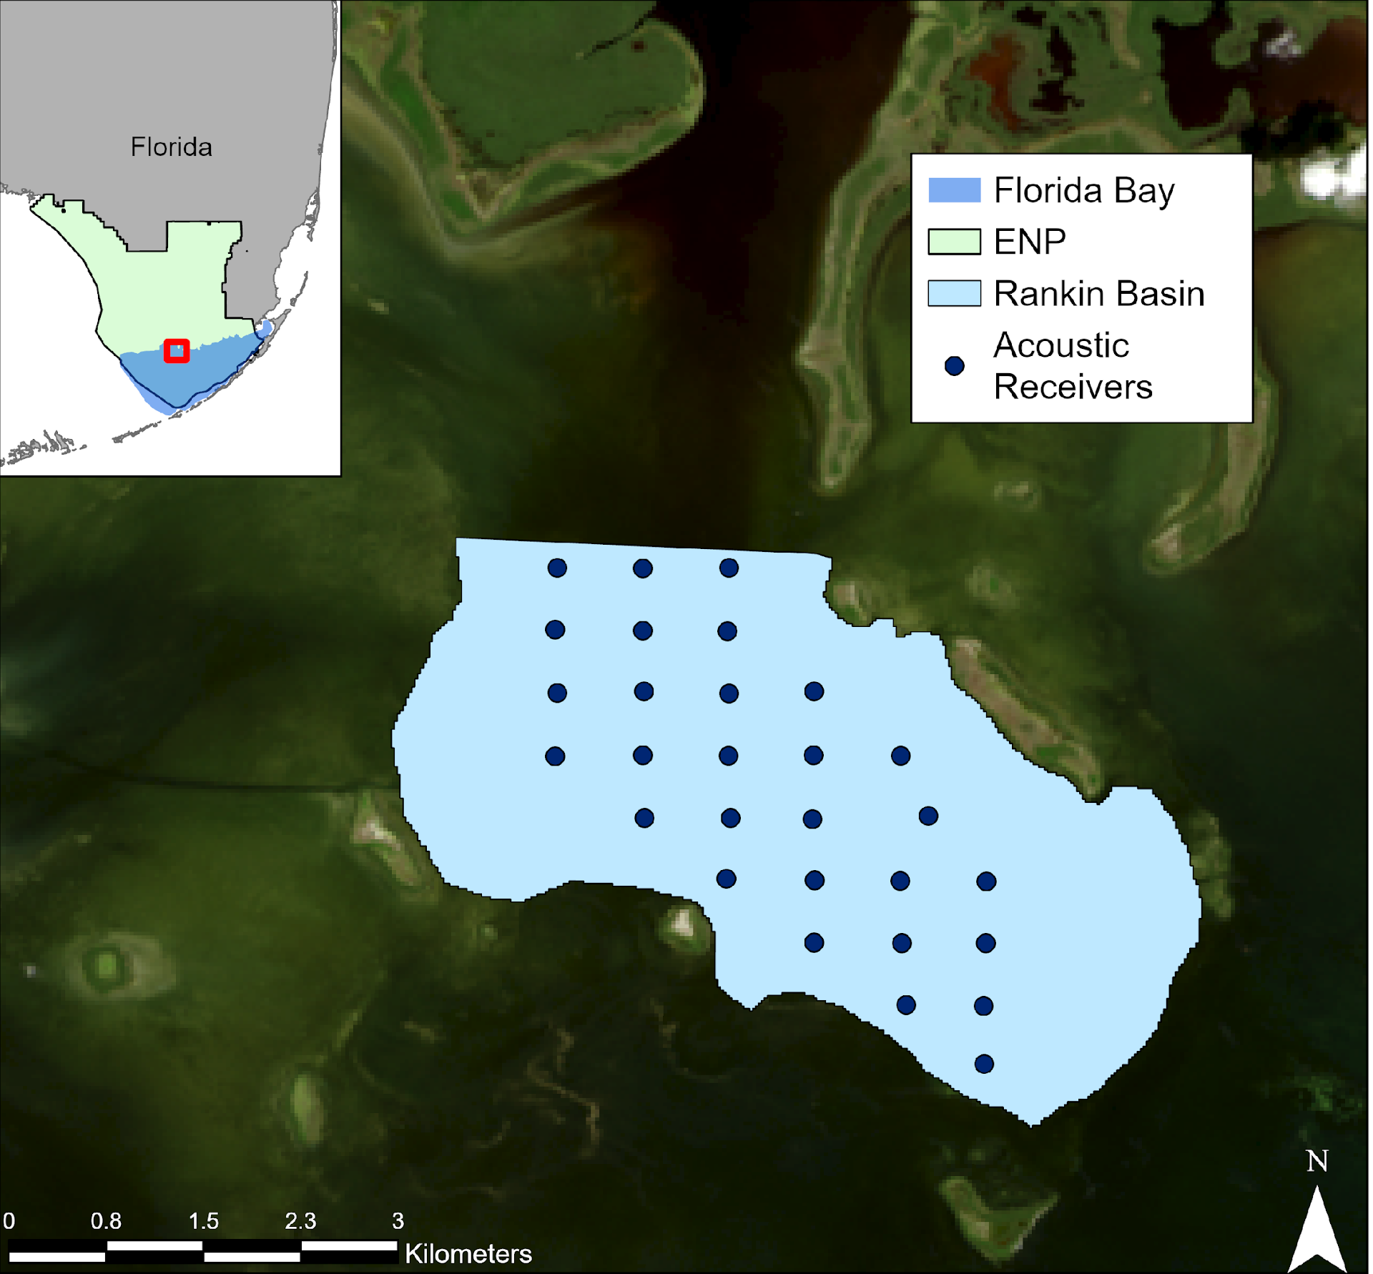
Methods
29 receivers
151 tagged seatrout
Using a subset of 8 individuals
Heupel et al., 2006 Mar Fresh Res, Brownscombe et al., 2019 Rev Fish Bio Fisheries
Notes:
To investigate spotted seatrout habitat use, I established an array of 29 Innovasea acoustic receivers within Rankin Basin. These acoustic receivers were placed in a grid pattern to facilitate the study of habitat use and home range estimation. Each of these receivers had a detection range of approximately 75m. A total of 151 spotted seatrout were tagged with V9 acoustic tags with either a 60-90s signal delay or 20-40s signal delay.

Slide 20
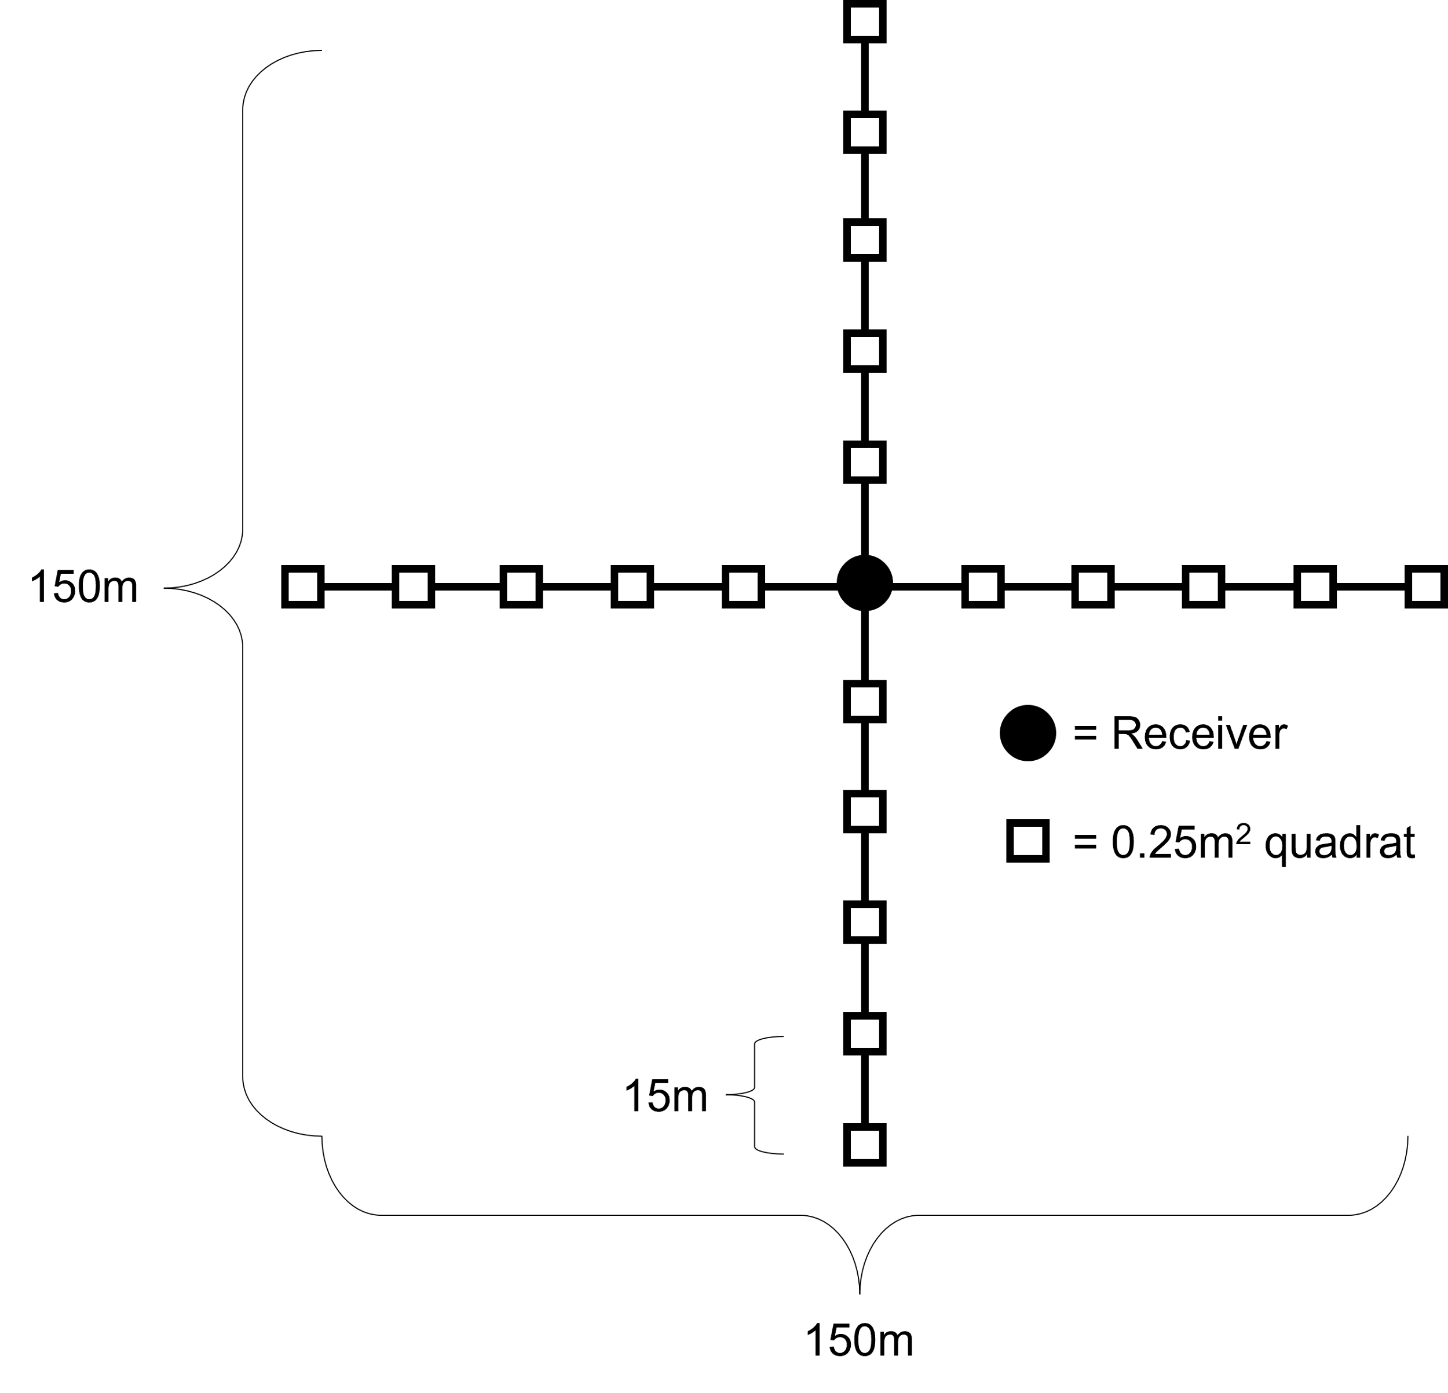
Methods
Notes:
SAV surveys were performed annually around each receiver to determine the within-patch characteristics of the SAV seascape. Two 150m crossed transects running East-West and North-South were centered at each receiver’s location and SAV was quantified every 15m within a 0.25m² quadrat for a total of 20 quadrats per receiver.

Slide 21
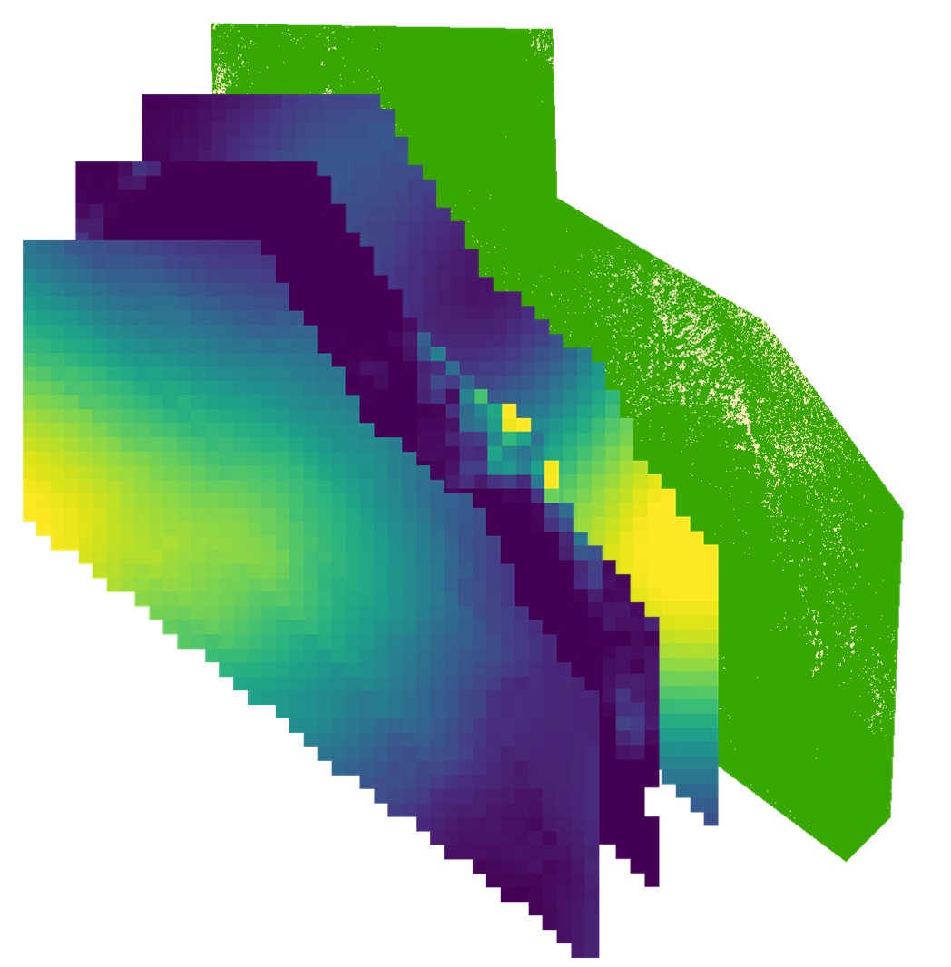
RSF – Methods
Methods
Receiver SAV surveys
FHAP SAV surveys
Aerial imagery
Notes:
Habitat variables were mapped at the 2 scales. A 2-class random forest classifier following the methodology in the SAV die-off chapter was on run on aerial imagery for the seascape scale. Ordinary kriging interpolation was used to map habitat variables for the within-patch scale. Seascape level variables were then calculated using spatial pattern metrics across the 2-class random forest classifier on the dense SAV class similar to the SAV die-off chapter. Data from the Fish Habitat Assessment Program, or FHAP, was also used to map species cover of Thalassia and Halodule. For this example we are only looking at within-patch variables

Slide 22
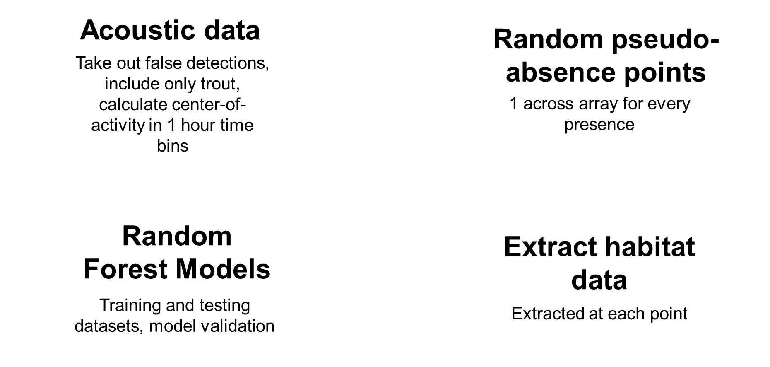
Methods
Notes:
For our analysis we used a resource selection functions to determine Seatrout habitat use. We took out false detections and included only detections from Seatrout. We then calculated center-of-activity points, or COAs, using a 1-hour time bin. We then created 1 random pseudo-absence point across the array for every presence point. This is to simulate absences for the resource selection function. Habitat data was then extracted from our maps at each point and then Random forests were used to calculate habitat preference

